Slide 1
202 - INFORMATION SYSTEMS IN DIGITAL ENVIRONMENT
(ISD)
ඩිජිටල් පරිසරයේ තොරතුරු පද්ධති
Association of Accounting Technicians of Sri Lanka

Slide 2
Ethical, Social and Legal Environment for Information Systems
තොරතුරු පද්ධති සඳහා සදාචාරාත්මක, සමාජීය සහ නෛතික පරිසරය

Slide 3
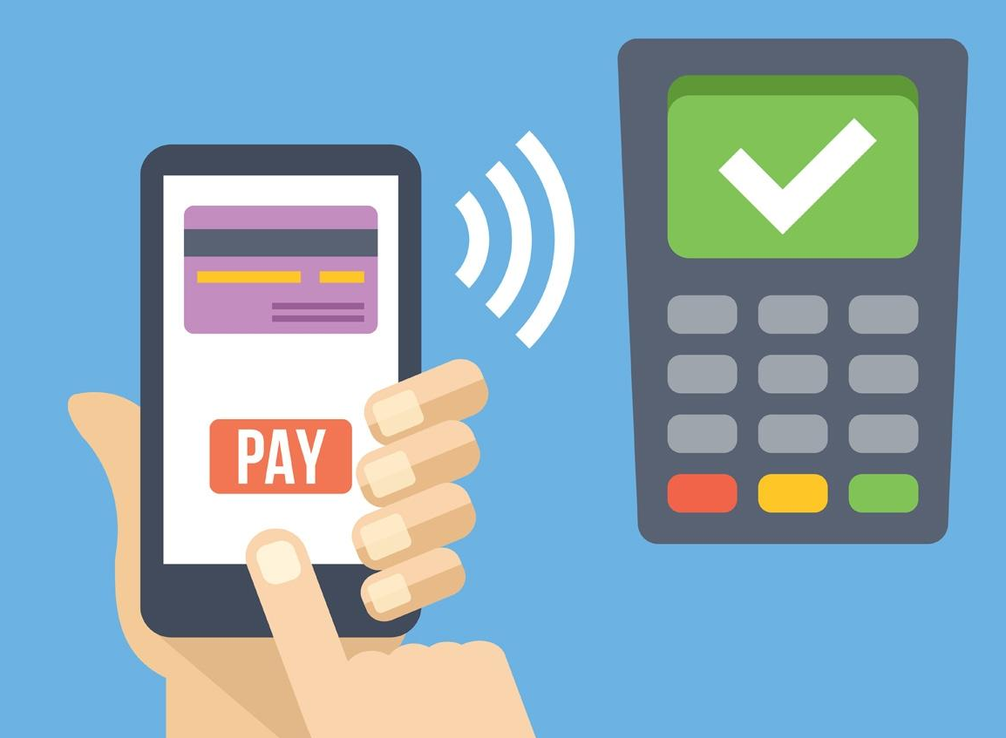
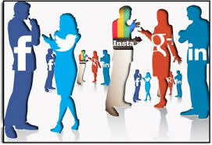
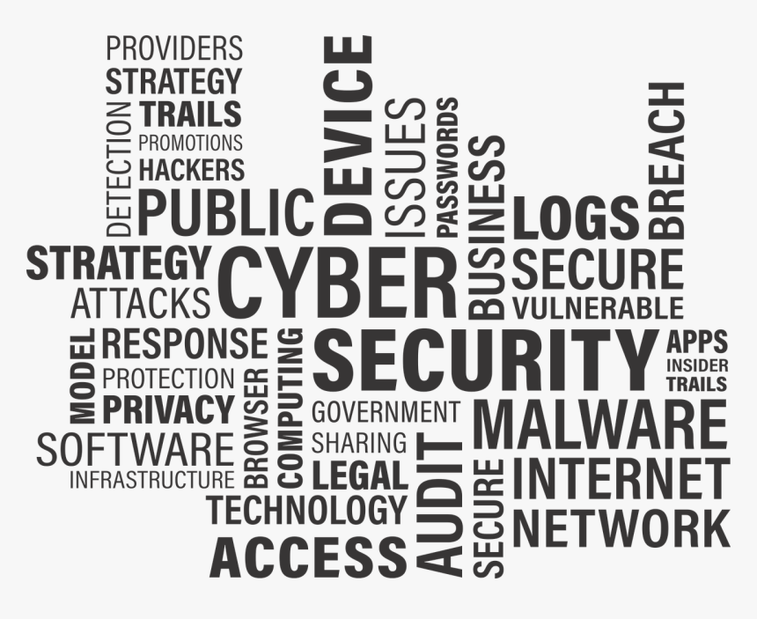



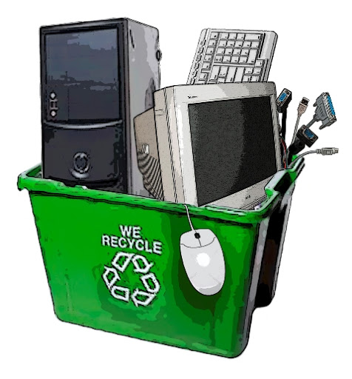
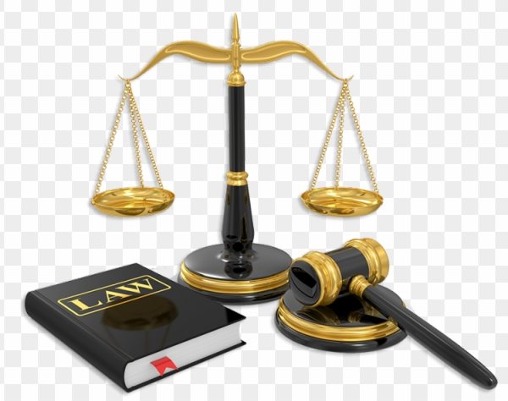


Slide 4
Ethical, Social and Legal Environment for Information Systems
තොරතුරු පද්ධති සඳහා සදාචාරාත්මක, සමාජීය සහ නෛතික පරිසරය
Social Networks and Social Media
Services Available for Personal Use and Their Features
Services Available for Professional Use and Their Features
Positive Impacts of Social Media and Networks on Individuals, Society and Business
Negative Impacts of Social Media and Networks on Individual and Society
What Is “Green Computing”
E-Waste and Its Impact on The Environment
Best Practices to Reduce Impact on Environment
Information Security and Privacy
Basic Understanding of Legal Regulations in Sri Lanka Related to IT and IS
Cyber Security
Data Protection

Slide 5
1. Social Networks and Social Media

Slide 6

1. Social Networks and Social Media
Many people think that social media and social networking are the same and therefore can be used interchangeably. That is a misconception.

Slide 7
Social Media vs. Social Networking
Social Media
Social Networking
media (content) that people upload
blog
video
slideshow
eBook
what media that the publisher is going to use
Facebook
Instagram
Twitter
linkedin

Slide 8
Social Media vs. Social Networking
Social Media
Social Networking
Social media is the media (content) that people upload, whether that’s a blog, video, slideshow, podcast, newsletter or an eBook.
Consider social media as a one-to-many communication method. Although people can respond and comment, the ownership remains with the publisher of the content.
Once decided what media that the publisher is going to use, begin with social networking sites like Facebook and Twitter to engage with audience. (Social media platforms)

Slide 9
Social Networks - Opportunities to Connect with Prospective Audience
Web links
Posts
News stories
Notes
Photo sharing
Blog posts
Direct messages, questions and comments
Branch out with other social networking platforms like LinkedIn and Pinterest

Slide 10
Social Networking Goal and Strategy
To develop a digital strategy, it is important decide what types of media that needs to create and use on social networking to build up following, so one can brand him/herself.

Slide 11
2. Services Available for Personal Use and Their Features

Slide 12



2. Services Available for Personal Use and Their Features
Services
Easy way to connect with friends
Content creation
Content publishing
Research and analysis
Education and consulting
Campaign
Community management
Features
Statuses
Pictures and videos
Share
Comment
Tag
Chat
Like

Slide 13
3. Services Available for Professional Use and Their Features

Slide 14
3. Services Available for Professional Use and Their Features
Among many social media, “LinkedIn.com” is probably the best web site to network and connect with professionals in your field, as it is the largest professional network in the world.
Like LinkedIn.com, “Twitter” is another web site that can also help connect to network with professionals in a more casual way. If someone is searching for a job, they can set up a Twitter profile and go public. Moreover, make sure published tweets are professional, relevant, informational and interesting. These behaviors will help to get better impression and to be noticed among many.
These sites allow to exchange information quickly and easily, gather with friends and family online and potentially get hired in the field that one’s searching.
Higher the use of social media, the more it will help to build connections all over the country or even world.

Slide 15
4. Positive Impacts of Social Media and Networks on Individuals, Society and Business

Slide 16
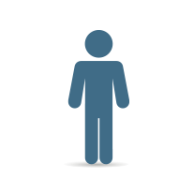
4. Positive Impacts of Social Media and Networks on Individuals, Society and Business
Socializing - to socialize and make friends
Sharing knowledge – simply access the information
Learning from various sources
Sharing health information
Sharing what they feel or think
Helps in speedy communication

Slide 17

4. Positive Impacts of Social Media and Networks on Individuals, Society and Business
Connectivity - People from anywhere can connect with anyone
Education - It is very easy to educate from others who are experts and professionals via the social media
Help - You can impart your issues to the group to get help and energy
Advertising – We can promote our business to the largest audience
Noble Cause - The public is making use of social media for contribution for needy people and it can be a quick way to help such people

Slide 18
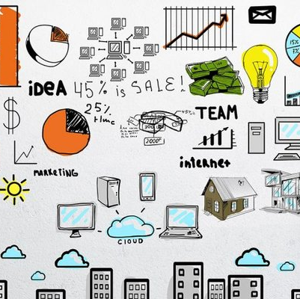
4. Positive Impacts of Social Media and Networks on Individuals, Society and Business
To understand the customer requirements.
To promote the Business all over the World.
To share customer experiences.
To gain key information about your competitors.
To share contents about the Business faster and easier.
To appeal to younger, social-savvy customers.
To provide better customer service and customer satisfaction

Slide 19
4. Positive Impacts of Social Media and Networks on Individuals, Society and Business
To increase market insight and expand out beyond your rivals with online networking.
To increase awareness among customers for better understanding of products.
To positioning power over competitors
To uncover industry trends in real-time.
To do comprehensive competitive analysis.
To recruit suitable workforces.

Slide 20
5. Negative Impacts of Social Media and Networks on Individual and Society

Slide 21
5. Negative Impacts of Social Media and Networks on Individual and Society
Generally
Fake news and Misinformation
Negative customer reviews are harmful
Highly time consuming
Cyber Harassing
And
Cyber bullying
Hacking
Addiction
Loss of reputation

Slide 22
6. Green Computing

Slide 23
6. Green Computing
Environmental Protection Agency (EPA)
Green computing is the process of designing, manufacturing/engineering, using and disposing of computing devices in a way that reduces their environmental impact.

Slide 24
6. Green Computing
Green Use
Green Disposal
Green Design
Green Manufacturing
Reducing the energy consumption of computers and other information systems as well as using them in an environmentally sound manner.
Refurbishing and reusing old computers and recycling discarded computers and other electronic equipment.
Designing energy efficient and environmentally sound components, computers, servers and cooling equipment.
Manufacturing electronic components, computers and other associated sub systems with minimal impact or no impact on the environment

Slide 25
Green Computing Work Habits
Power-down the CPU and all peripherals during extended periods of inactivity.
1
Try to do computer-related tasks during contiguous, intensive blocks of time, leaving hardware off at other times.
2
Power-up and power-down energy-intensive peripherals such as laser printers according to need.
3
Use the power-management features to turn off hard drives and displays after several minutes of inactivity.
4
Minimize the use of paper and properly recycle waste paper.
5
Dispose of e-waste according to federal, state and local regulations.
6
Employ alternative energy sources for computing workstations, servers, networks and data centers.
7

Slide 26
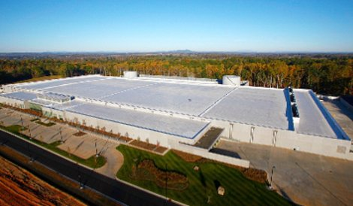
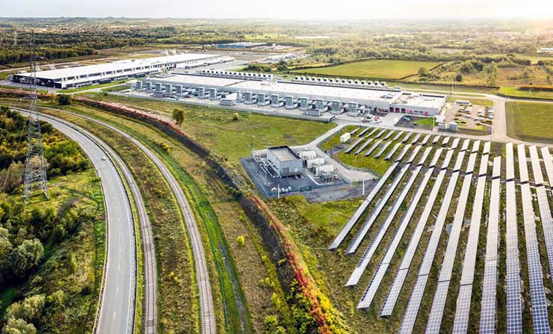
An on-site solar energy array at the Google data center campus in Belgium
An aerial view of the new Apple data center in Maiden, North Carolina, excerpted by a video by area real estate agent Bill Wagenseller

Slide 27
Advantages of Green IT
Less energy usage and costs
Investors and consumers attraction
Competitive advantages

Slide 28
Adoption of Green Computing
The following factors are driving to adopt green computing practices.
Rapid Growth of the Internet
Increasing Equipment Power Density
Increasing Cooling Requirements
Increasing Energy Costs
Restrictions on Energy Supply and Access
Low Server Utilization Rates
Growing Awareness about impact of IT on the Environment

Slide 29
7. e-Waste and Its Impact on the Environment

Slide 30
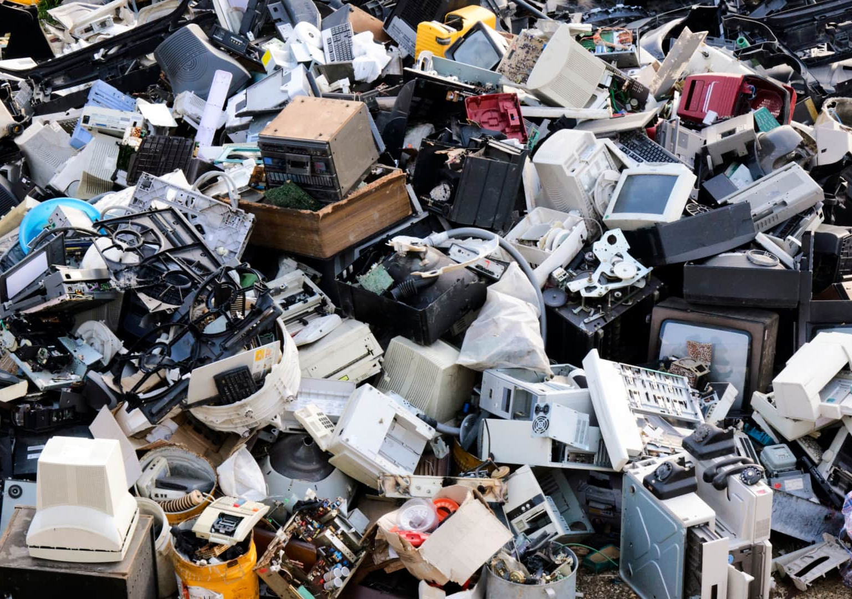
7. e-Waste and Its Impact on the Environment
Treating and processing e-waste is an expensive task and space becomes a huge challenge

Slide 31
National Laws, Regulations and Standards on e-waste Management in Sri Lanka
Managing
e-waste
Ministry of Environmental and Renewable Energy (MoERE)
Central Environmental Authority (CEA)
The CEA was established in 1981 as the authority with regulatory powers for the environmental management under the National Environment (Amendment) Acts No. 56 of 1988 පනත)and No. 53 of 2000 (1988 අංක 56 සහ 2000 අංක 53 දරන ජාතික පරිසර (සංශෝධිත) පනත්.

Slide 32
Policies and Regulations
National Electrical and Electronic Waste Management Policy in Sri Lanka
Policy on E waste management was drafted and called for public comments in 2008
The National Environmental (Protection & Quality) regulation No. 01 of 2008 published by the gazette notification No 1534/18 on 01.02.2008, published a list of Waste Electrical and Electronic Equipment(WEEE) as Hazardous waste (උපද්‍රවකාරී අපද්‍රව්‍ය).
According to this regulation generator, collector, storer, recycler, recover and disposer should obtain a License for Scheduled Waste Management (SWM License) from the Central Environmental Authority.

Slide 33
8. Best Practices to Reduce Impact on Environment

Slide 34
8. Best Practices to Reduce Impact on Environment
Printing
Printing should be done carefully and only those pages should be printed that are indispensable. Apart from electricity, this will save lot of paper and consequently lower cutting down of trees
Refilling
Refilling of ink cartridges and laser toners are cheaper and does not add to landfill. Hence should be carried out
Switching off
IT hardware devices should be turned off when not in use

Slide 35
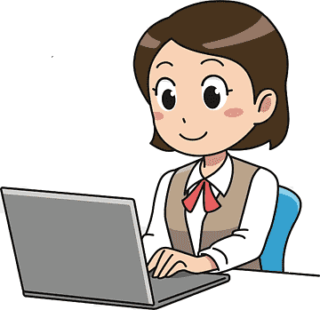
8. Best Practices to Reduce Impact on Environment
8.1 End User
Most personal computers (PC) run even when they are not being used, wasting enormous amount of electricity

Slide 36
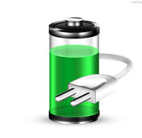
Reduction of PC Energy Consumption
Enabling power management features
  Software solutions can be used in computer power management

Slide 37
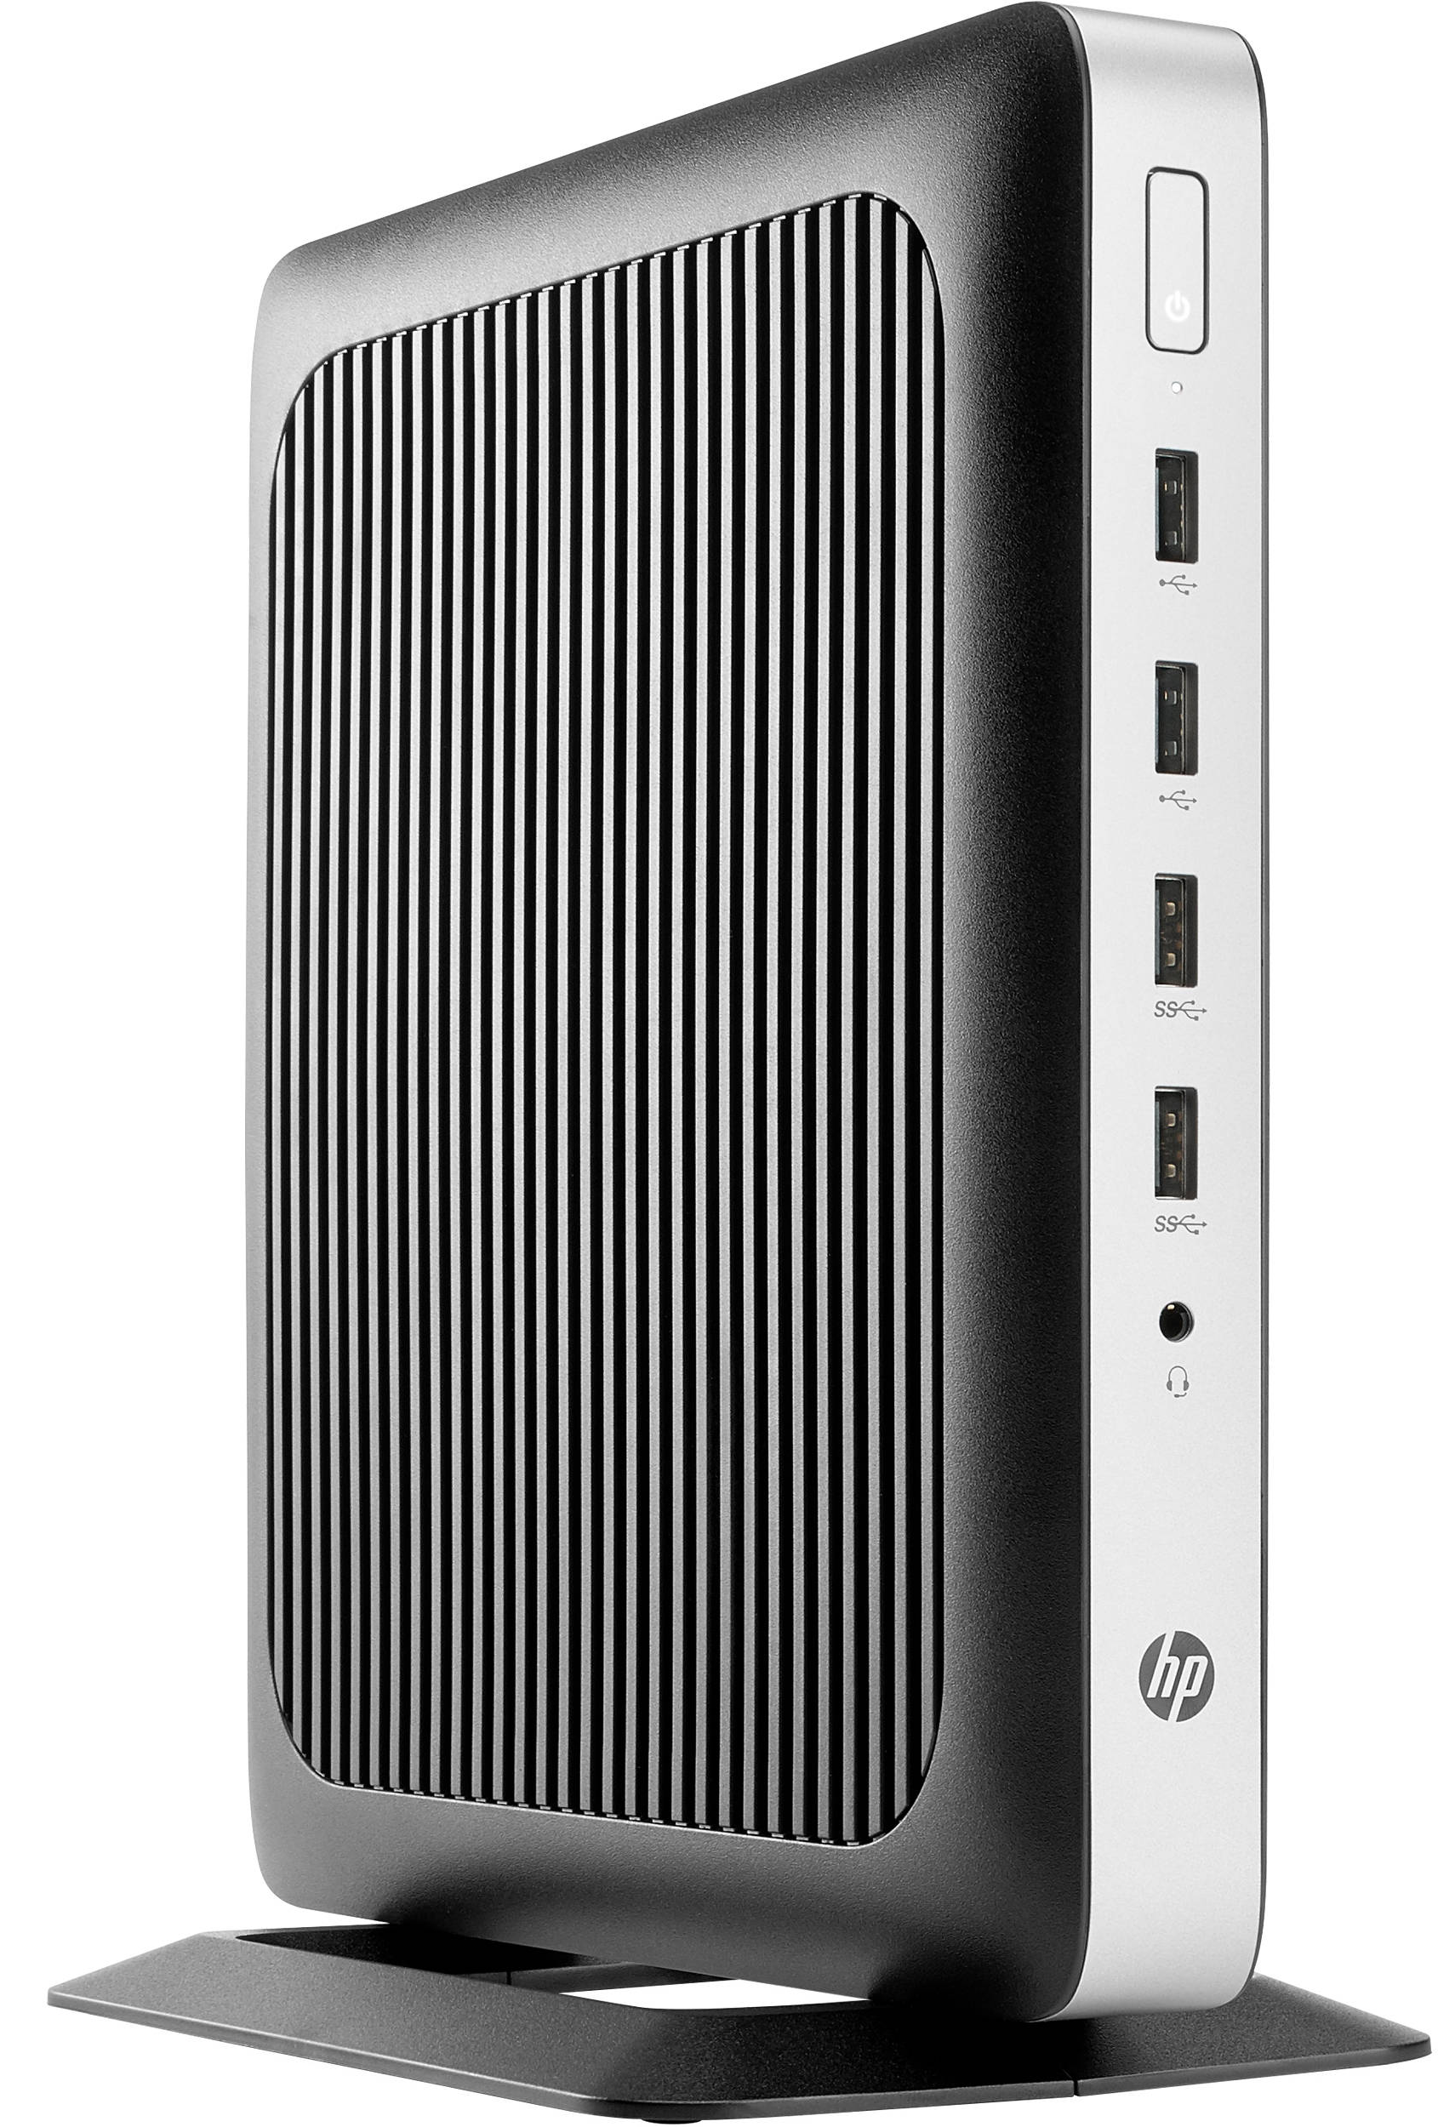
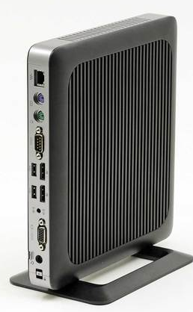
Reduction of PC Energy Consumption
Using thin client/Zero client computers

Slide 38
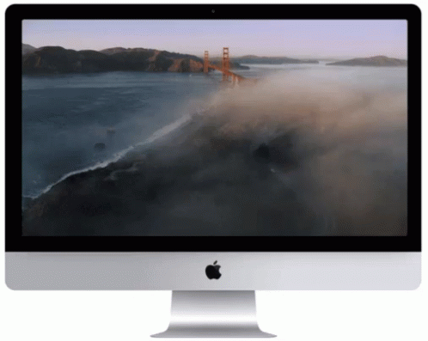
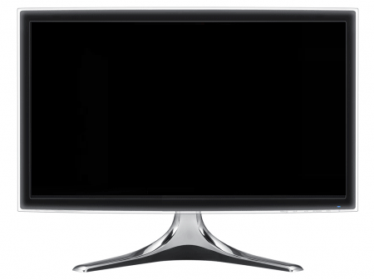
Reduction of PC Energy Consumption
Using screensavers
Software solutions can be used in computer power management

Slide 39
8.2 Reuse of Computers
Reuse
An old computer can be given to someone who needs it or the functional components may be used from a retired product
Refurbish
Old computers and servers can be refurbished to meet new requirements
Recycle
When computers cannot be reused, they must be disposed properly in environmentally friendly ways

Slide 40
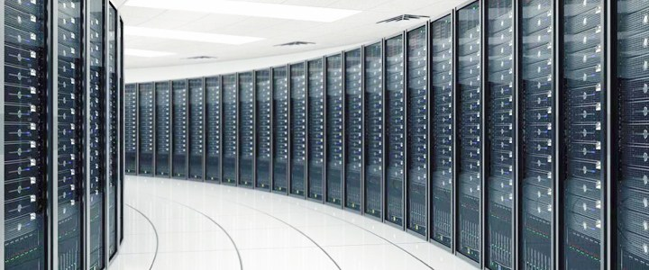
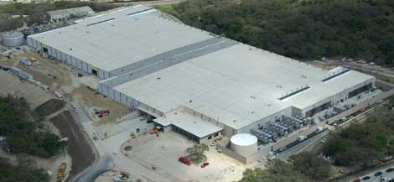
8.3 Data Centers
Data Centre is a building, dedicated space within a building, or a group of buildings used to house computer systems and associated components, such as telecommunications and storage systems

Slide 41
8.3 Data Centers
The number of server computers in data centers has increased many millions in the last decade, and each server draws far more electricity than earlier models.

Slide 42
8.3 Data Centers
Data center efficiency can be improved by using new energy-efficient equipment, improving airflow management to reduce cooling requirements, investing in energy management software, and adopting environmentally friendly designs for data centers and new measures to control data centers’ energy consumption.

Slide 43
Greening Data Centers
Energy Conservation
Eco-friendly design
Virtualization

Slide 44
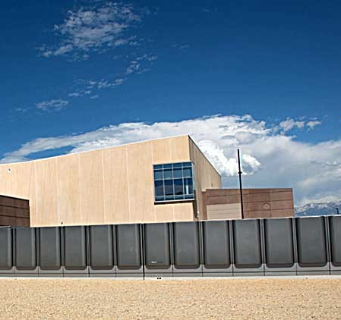
Energy Conservation
Companies like IBM, Hewlett Packard, and SprayCool are working on technologies such as liquid cooling, nano-fluid cooling systems, and in-server, in-rack, and in-row cooling.
Other novel ways of making a data center more environmentally friendly include using new high-density servers, using hydrogen fuel cells as alternative green power sources, and applying virtualization technologies that reduce the total power consumption of servers and lower the heat generated

Slide 45
Eco-friendly Design
Use of environmentally friendly materials for constructions
Use of both natural light as well as green power (Renewable energy - පුනර්ජනනීය බලශක්තිය)
Can get tax incentives and gain a competitive advantage

Slide 46

Virtualization
In virtualization, one physical server hosts multiple virtual servers
Can host multiple virtual servers on a smaller number of more powerful servers, using less electricity and simplifying the data center

Slide 47

Green Computer Design
Green computer design aims to reduce the environmental impact of computers by adopting new technologies and using new techniques to consume less and less of electrical power and non-toxic materials while balancing environmental compatibility with economic viability and performance.

Slide 48
9. Information Security and Privacy

Slide 49

What Is Information Security?
Information security (infosec), is a set of practices intended to keep data secure from unauthorized access or alterations, both when it's being stored and when it's being transmitted from one machine or physical location to another.

Slide 50
Information security concepts
Confidentiality
Integrity
Availability

Slide 51
Information Security Concepts
Confidentiality means protecting data, in all its forms, from unauthorized access throughout its entire lifecycle (from data creation to data destruction)
Integrity means ensuring that data within IT systems (or recorded or reproduced on physical media) are accurate.
Availability means ensuring that data are available when needed and that IT systems are operating reliably.

Slide 52
Common Intentional and Malicious Information Security Threats
Malware
Spyware
Keystroke loggers
Backdoor access to IT systems
Phishing and targeted scams designed to steal user credentials
Intentional misuse by someone with legitimate access
Denial of service (DoS) attacks intended to make data unavailable.
Notes:
In addition to intentional and malicious threats, those who manage IT systems and the data contained in them must protect them from unexpected or accidental events such as, natural disasters, power outages, and lost or misplaced IT resources (e.g., a lost thumb drive containing sensitive data). They also must protect data and related systems from the unintentional actions of legitimate users, such as the accidental deletion of important data, accidentally posting sensitive data to a public-facing resource (e.g., a web page), or sending it to the wrong person (e.g., via email).

Slide 53

What is Privacy?
Privacy means the right of an individual to control his or her own data and to specify how those data are collected, used, and shared.

Slide 54
10. Legal Regulations in Sri Lanka Related to IT and IS

Slide 55
Legal Regulations in Sri Lanka Related to IT and IS
2003
Intellectual Property Act No 36 of 2003
2003
Information and Communication Technology Act No 27 of 2003
2005
Payment and Settlement Systems Act No 28 of 2005
2006
Electronic Transactions Act No 19 of 2006
2006
Payment Devices Fraud Act No 30 of 2006
2007
Computer Crimes Act No 24 of 2007
2016
Right to Information Act No 12 of 2016
2017
Electronic Transactions (Amendment) Act No 25 of 2017

Slide 56



Intellectual Property Act No 36 of 2003
(2003 අංක 36 දරන බුද්ධිමය දේපළ පනත)
Main objective is to protect intellectual properties such as Copy right, patents, trademarks, trade names etc.
National Intellectual Property Office (NIPO) is the sole authority that administering intellectual properties

Slide 57

Information and Communication Technology Act No 27 of 2003 (2003 අංක 27 දරන තොරතුරු හා සන්නිවේදන තාක්ෂණ පනත)
The Information and Communication Technology Agency of Sri Lanka (ICTA) was established in July 2003 and pursuant to Information and Communication Technology Act No. 27 of 2003, (ICT Act)
ICTA was empowered to formulate and implement strategies and programs in both the Government and the private sector
ICTA prepared programs and strategies on Information and Communication Technology, which are presently embodied in the “e-Sri Lanka Development Project”.
INFORMATION AND COMMUNICATION. TECHNOLOGY (AMENDMENT). ACT, No. 33 OF 2008

Slide 58

Payment and Settlement Systems Act No 28 of 2005 (2005 අංක 28 දරන ගෙවීම් හා බේරුම් කිරීමේ පද්ධති පනත)
Objectives of the Act
to provide for the regulation, supervision and monitoring of payment, clearing and settlement systems
to provide for the disposition of securities in securities accounts maintained at the Central Bank
to provide for the regulation, supervision and monitoring of providers of money services
to facilitate the electronic presentment of cheques

Slide 59

Electronic Transactions Act No 19 of 2006 (2006 අංක 19 දරන ඉ‍ලෙක්ට්‍රොනික ගනුදෙනු පනත)
Objectives of the Act
to facilitate domestic and international electronic commerce
to encourage the use of reliable forms of electronic commerce
to facilitate electronic filing of documents with government and to promote efficient delivery of government services by means of reliable forms of electronic communications
to promote public confidence in the authenticity, integrity and reliability of data messages and electronic communications

Slide 60
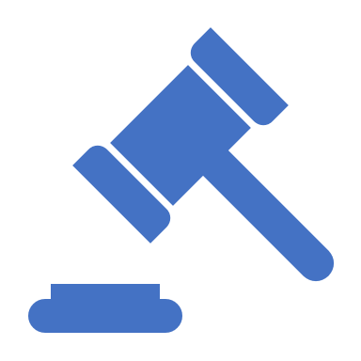
Payment Devices Fraud Act No 30 of 2006 (2006 අංක 30 දරණ ගෙවීම් උපක්‍රම වංචා පනත)
Help to prevent the possession and use of unauthorized or counterfeit payment devices, to create offences connected with the possession or use of unauthorized payment devices, to protect persons lawfully issuing and using such payment devices, to make provision for the investigation, prosecution and punishment of offenders and to provide for matters connected

Slide 61
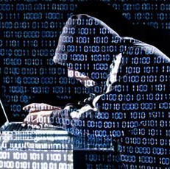
Computer Crimes Act No 24 of 2007
(2007 අංක 24 දරන පරිගණක අපරාධ පනත)
The basis of the Computer Crimes Act No. 24 of 2007 is to criminalize attempts at unauthorized access to a computer, computer program, data or information. It also contains a provision to deal with unauthorized use of computers regardless of whether the offender had authority to access the computer.
The act creates offences for unauthorized modification, alteration or deletion of information and denial of access, which makes it an offence for any person to program the computer in such a manner to prevent authorized persons from obtaining access

Slide 62

Right to Information Act No 12 of 2016
(2016 අංක 12 දරන තොරතුරු දැන ගැනීමේ අයිතිවාසිකම පිළිබද පනත)
Right to Information Act No 12 of 2016, guarantees the right of access to information and there exists a need to foster a culture of transparency and accountability in public authorities by giving effect to the right of access to information and thereby promote a society in which the people of Sri Lanka would be able to more fully participate in public life through combating corruption and promoting accountability and good governance.

Slide 63
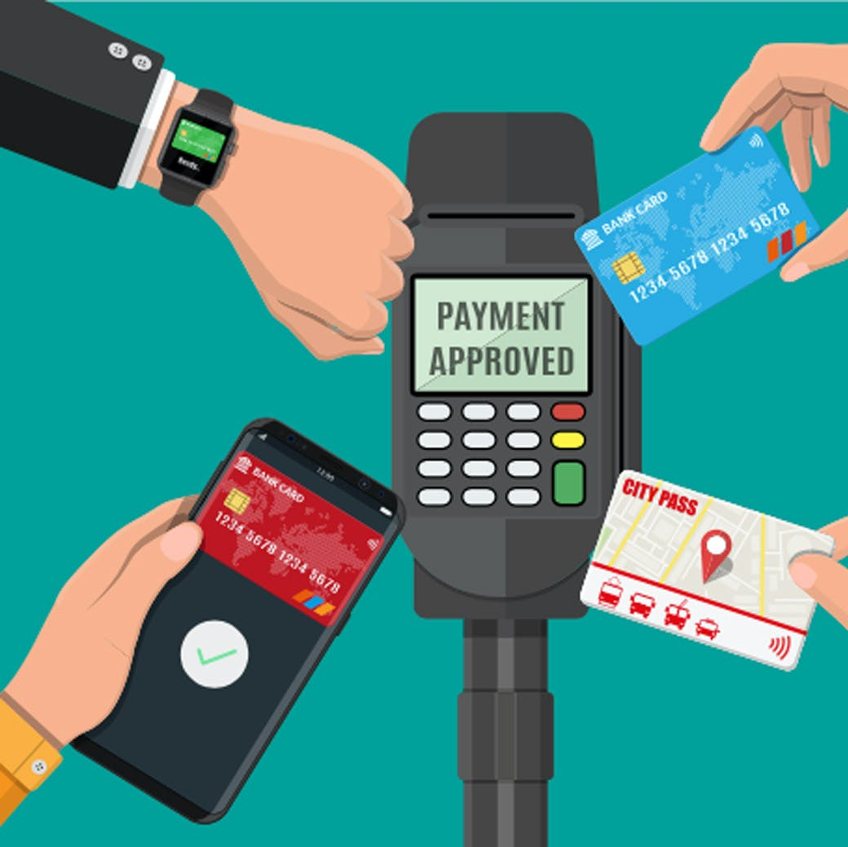
Electronic Transactions (Amendment) Act No 25 of 2017 (2017 අංක 25 දරන ඉලෙක්ට්‍රොනික ගනුදෙනු (සංශෝධන) පනත)
The objectives of the act
to facilitate electronic filing of any form, application, or any other document with any ministry, department, provincial council, provincial ministry and department or local authority or, office, body or agency owned or controlled by the Government or a statutory body in a particular manner and to promote efficient delivery of public service by means of reliable forms of electronic communications;
to promote public confidence in the authenticity, integrity and reliability of data messages, electronic documents, electronic records or other communications; and
to implement the provisions of the Convention subject to such restrictions specified in section 23 of this Act declared at the time of ratification of the Convention.

Slide 64
11. Cyber Security

Slide 65

Cyber Security
Cyber security is the name for the safeguards taken to avoid or reduce any disruption from an attack on data, computers or mobile devices. Cyber security covers not only safeguarding confidentiality and privacy, but also the availability and integrity of data.

Slide 66
Improving Cyber Security
Move away from using unsupported software
Always download and install the latest software and app updates
Run up-to-date anti-virus software
Use Strong Passwords
Delete suspicious emails and avoid clicking on unknown attachments or links
Back up data
Train Staff to be Cyber Aware
Manage Security Relationships With Suppliers And Partners

Slide 67
12. Data protection

Slide 68
What is Data Protection?
Data protection is commonly defined as the law designed to protect personal data.

Slide 69
Why is Data Protection Needed?
Every time a person use a service, buy a product online, register for email, go to a doctor, pay taxes, or enter into any contract or service request, they have to hand over some of their personal data.
With the expansion of information technology capabilities, business and government have been storing this personal data in databases. Databases can be searched, edited, cross-referenced, and their data shared with other organizations across the world.

Slide 70
Why is Data Protection Needed?
With the expansion of information technology capabilities, business and government have been storing this personal data in databases. Databases can be searched, edited, cross-referenced, and their data shared with other organizations across the world.
Once the collection and processing of data became widespread, people started asking questions about was happening to their data once they provided it.
  Who had the right to access the data?
  Was it kept accurately?
  Was it being collected and disseminated without their knowledge?
  Could it be used to discriminate or violate other fundamental rights?

Slide 71
How Does Data Protection Work?
There are no universally recognized data protection standards, but regional and international bodies have created internationally agreed upon codes, practices, decisions, recommendations, and policy instruments.

Slide 72
How Does Data Protection Work?
Data protection should ensure the following:
There should be limits on the collection of personal data, and it should be obtained by lawful and fair means, as well as being done in a transparent manner
The purposes for which the data and information is to be used should be specified (at the latest) at the time of collection, and should only be used for those agreed purposes. Personal data can only be disclosed, used, or retained for the original purposes (i.e. the purpose at the time of collection), except with the consent of the individual or under law: accordingly, it must be deleted when no longer necessary for that purpose
Personal data, as generated and processed, should be adequate, relevant, and limited to necessity of the purposes for which it is to be used

Slide 73
How Does Data Protection Work?
Data protection should ensure the following:
There should be limits on the collection of personal data, and it should be obtained by lawful and fair means, as well as being done in a transparent manner
The purposes for which the data and information is to be used should be specified (at the latest) at the time of collection, and should only be used for those agreed purposes. Personal data can only be disclosed, used, or retained for the original purposes (i.e. the purpose at the time of collection), except with the consent of the individual or under law: accordingly, it must be deleted when no longer necessary for that purpose
Personal data, as generated and processed, should be adequate, relevant, and limited to necessity of the purposes for which it is to be used

Slide 74
How Does Data Protection Work?
Data protection should ensure the following:
The data should be accurate and complete, and measures should be taken to ensure it is up to date
Reasonable security safeguards should be used to protect personal data from loss, unauthorized access, destruction, use, modification or disclosure
There should be no secret processors of data, sources, or processing. Individuals must be made aware of the collection and processing of their data, as well as the purpose of its use, who is controlling it, and who is processing it

Slide 75
How Does Data Protection Work?
Data protection should ensure the following:
Individuals have a range of rights, which enables them to control their personal data and any processing
Those that use personal data must be accountable for and demonstrate compliance with the ab

Slide 76


